Slide 1



Creating an AWS Account and installing filezilla

Slide 2
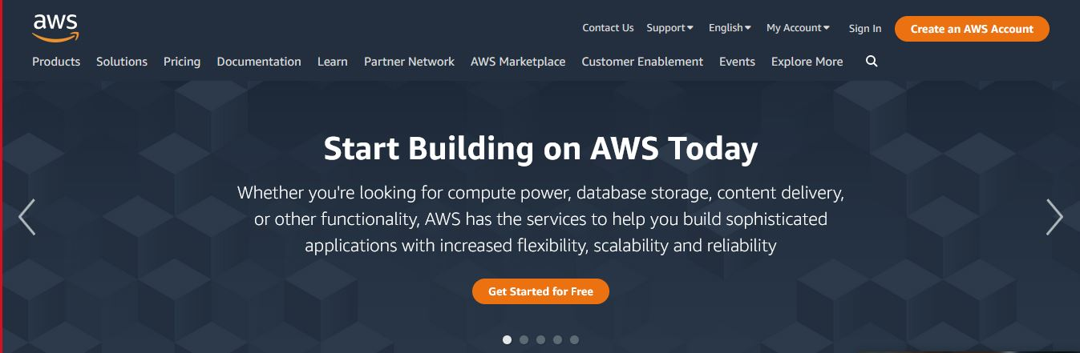
Creating an AWS Account
Open your web browser and navigate to:
https://aws.amazon.com/
Click “Create and AWS Account"

Slide 3
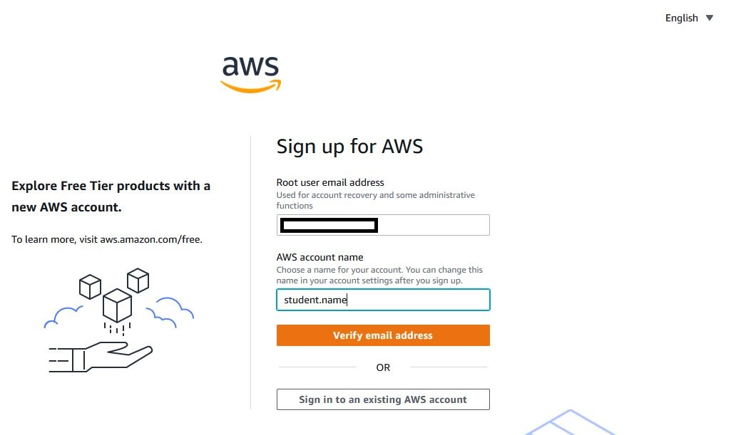
Creating an AWS Account
Fill in your email address and account name
Click “Verify email address"

Slide 4
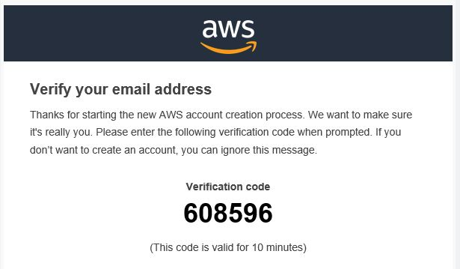
Creating an AWS Account
Obtain the code provided in the email message sent from AWS

Slide 5
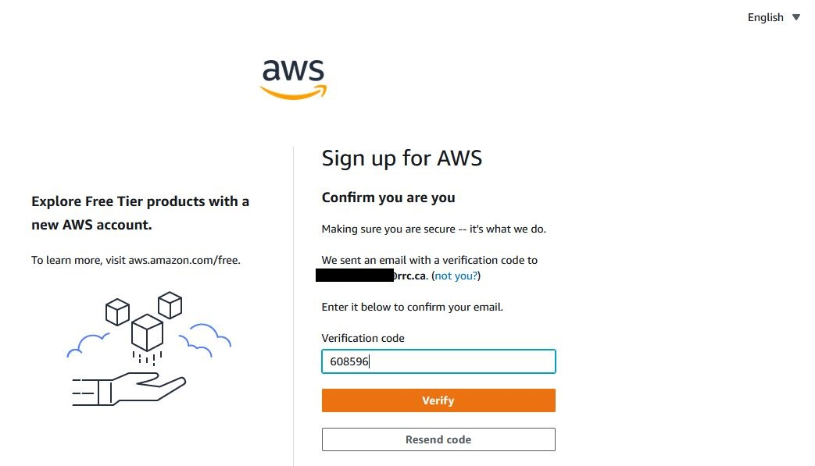
Creating an AWS Account
Enter the code into the Verification Code box
Click Verify

Slide 6
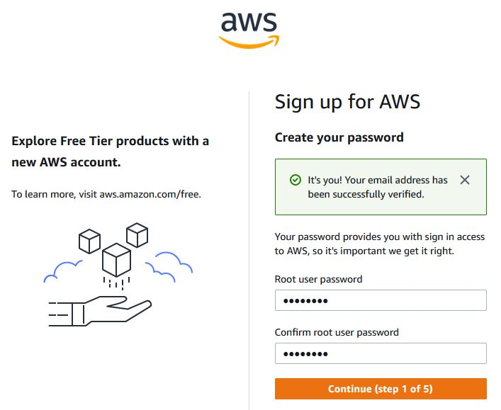
Creating an AWS Account
Enter a STRONG password

Slide 7
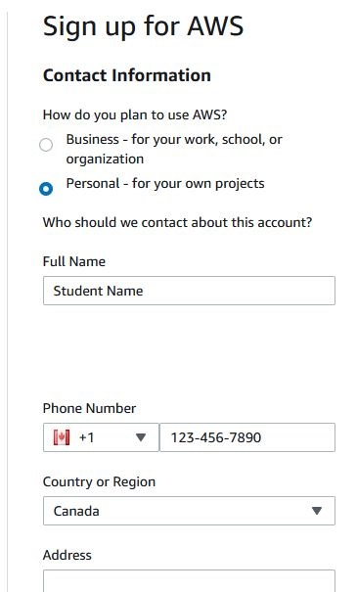
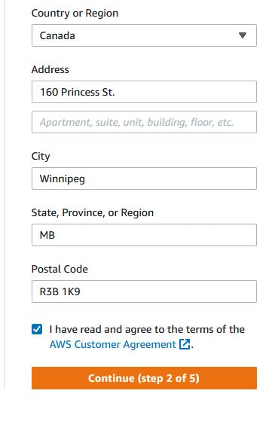
Creating an AWS Account
Select "Personal" account
Fill in your contact details
Agree to the terms
Click "Continue"

Slide 8
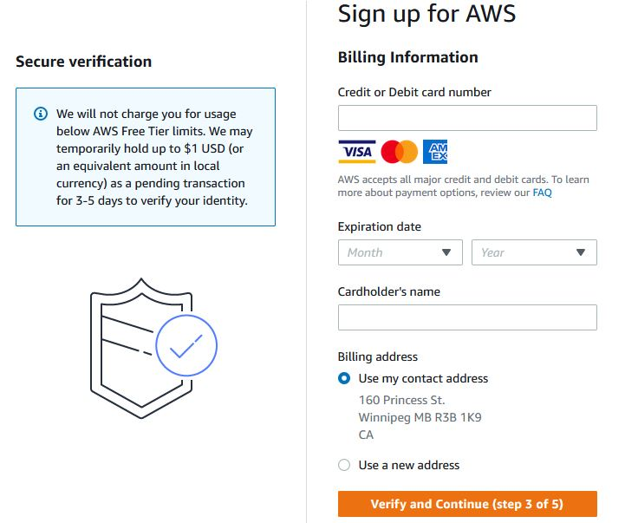
Creating an AWS Account
Enter payment information
Click “Verify and Continue"
AWS will charge $1 to your credit card, then immediately reimburse it, to ensure your card is valid.
You won't be charged anything else until your free tier expires and/or you use services that cost money

Slide 9
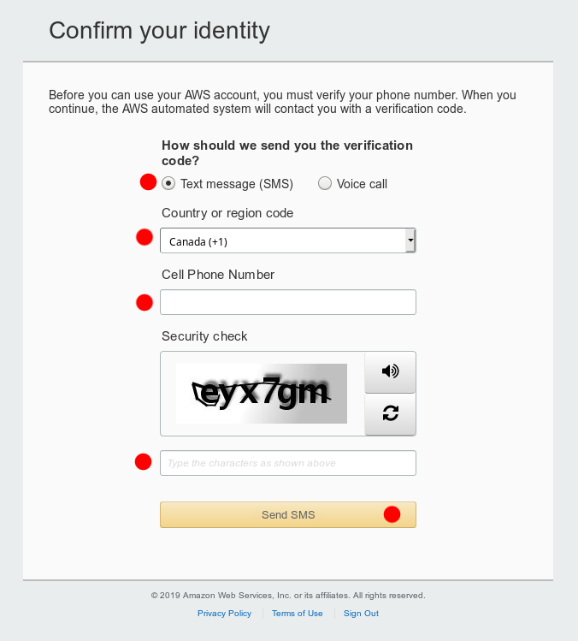
Creating an AWS Account
Fill in the info to confirm your identity
Type the Captcha characters
Click "Send SMS"

Slide 10
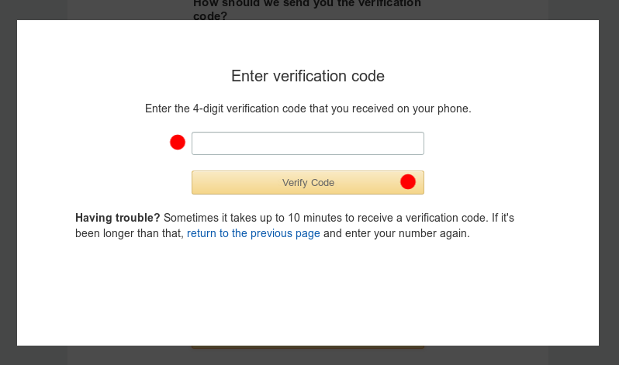
Creating an AWS Account
You should receive a code on your phone
Type in your code
Click "Verify Code"

Slide 11
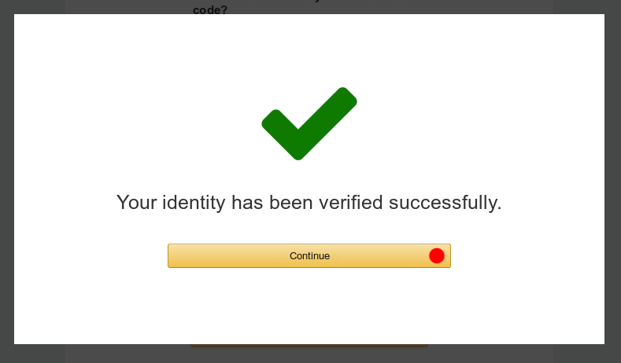
Creating an AWS Account
If everything went well, you should get the big green checkmark
Click "Continue"

Slide 12
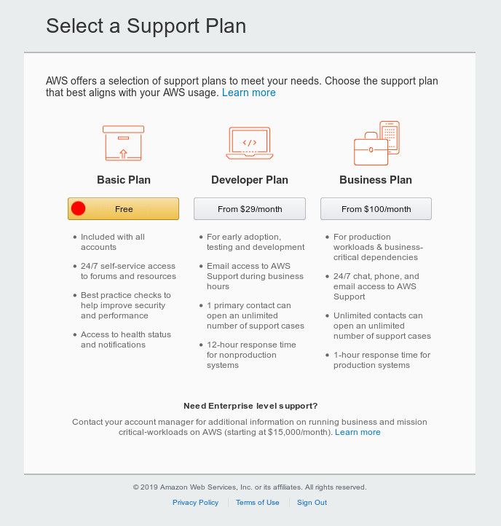
Creating an AWS Account
Choose the free "Basic Plan"

Slide 13
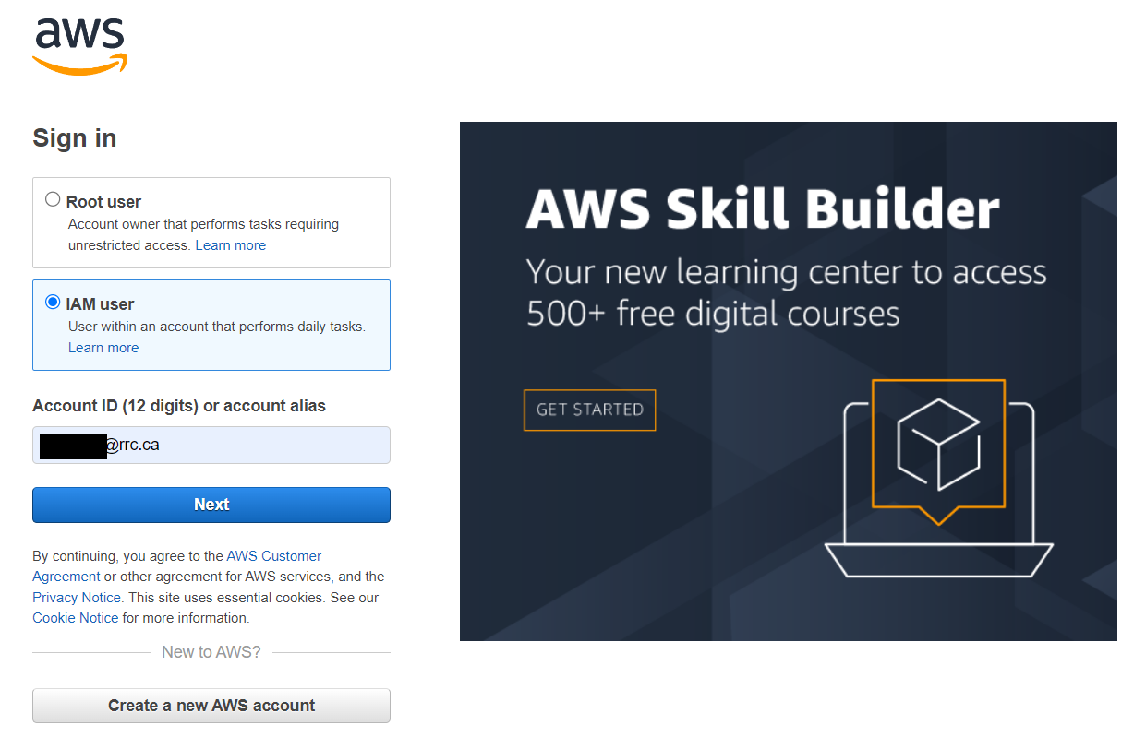
Creating an AWS account
Type in the email address and password you used to create your account

Slide 14
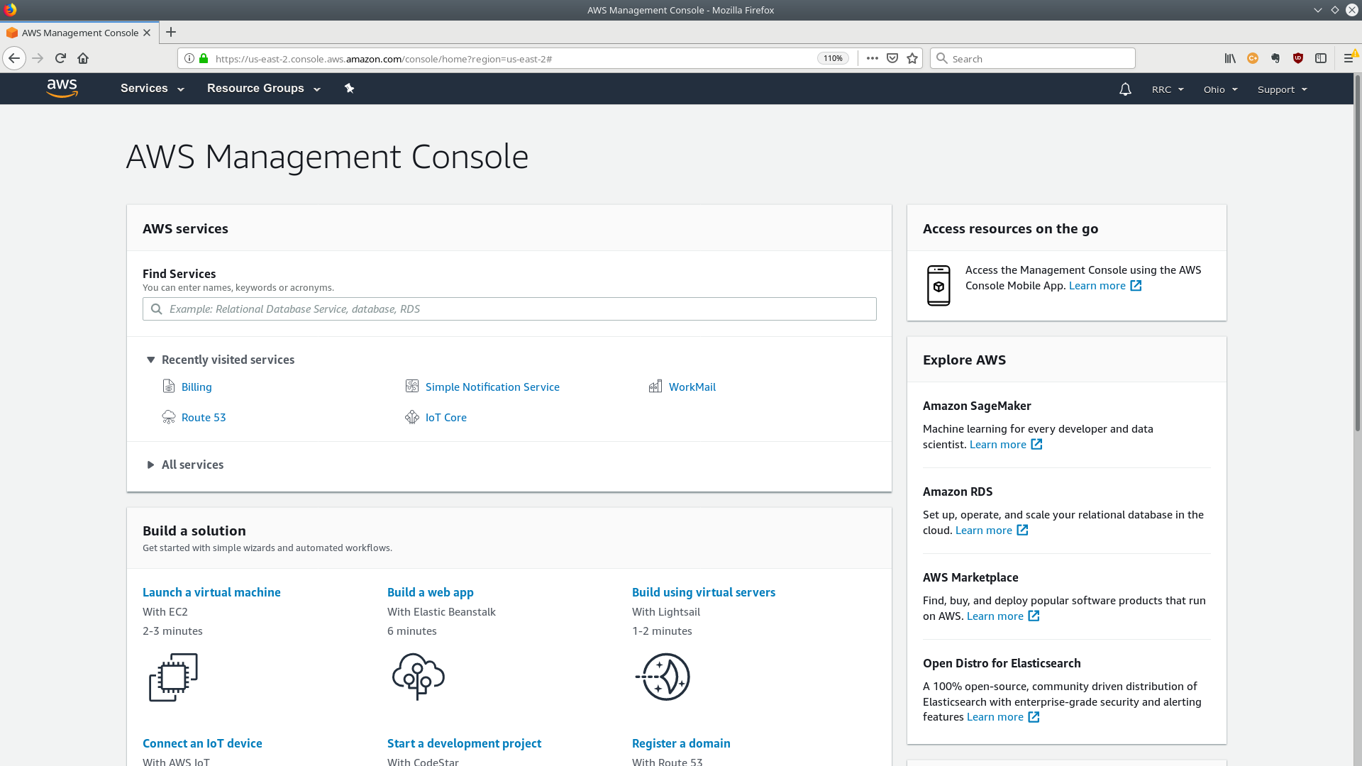
Creating an AWS Account
Welcome to the AWS Management Console
You can access all of the AWS services from here
In the next module we'll be setting up an admin user

Slide 15
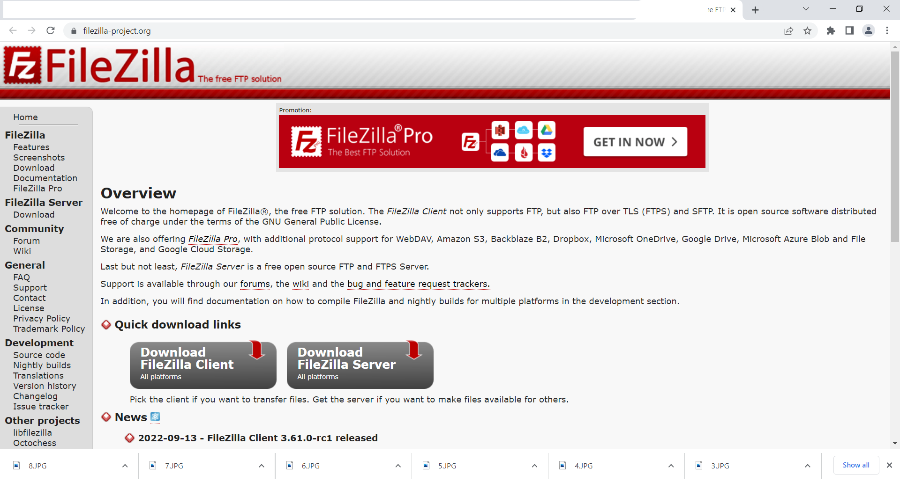
Filezilla
Filezilla will be used to securely transfer files from your host machine to an AWS Lightsail Instance
Go to https://filezilla-project.org/
Choose Download FileZilla Client

Slide 16
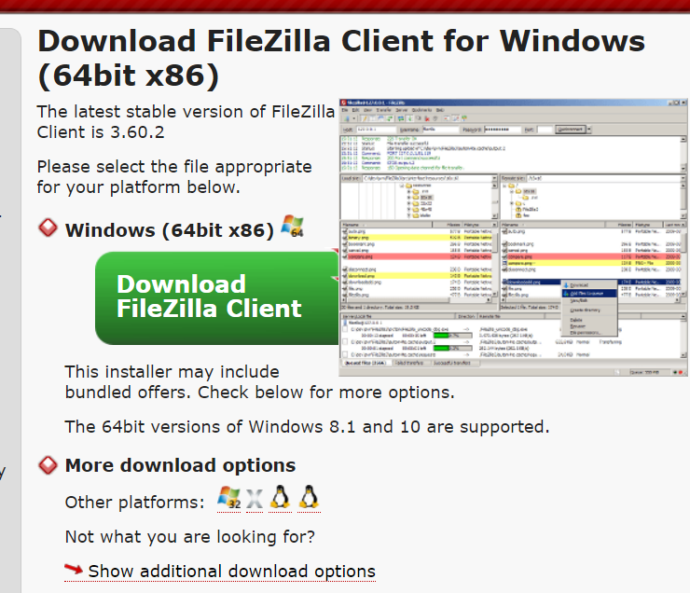
Filezilla
For Windows select the Download FileZilla Client button
For other platforms click on the appropriate link under: More download options

Slide 17
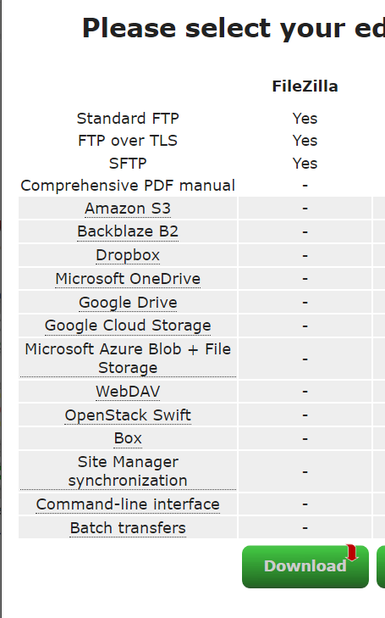
Filezilla
Filezilla will be used to securely transfer files from your host machine to an AWS Lightsail Instance
Go to https://filezilla-project.org/
Choose Download FileZilla Client

Slide 18
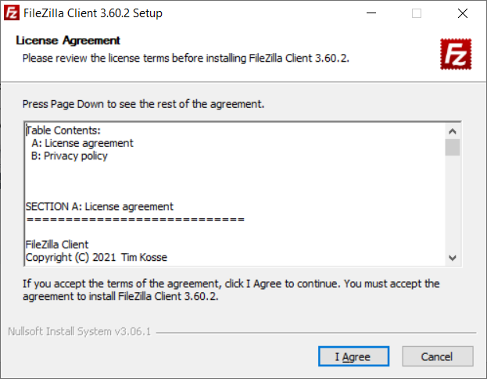
Filezilla
Once the file has been downloaded, run the executable
Click I Agree to the License Agreement

Slide 19
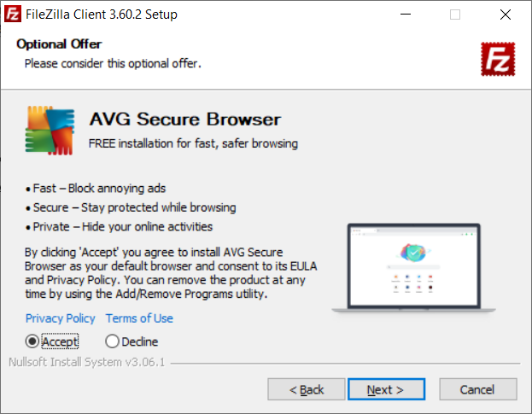
Filezilla
Choose Accept or Decline to the optional Browser Offer
NOTE: I chose decline (although screenshot has Accept clicked)
Click Next

Slide 20
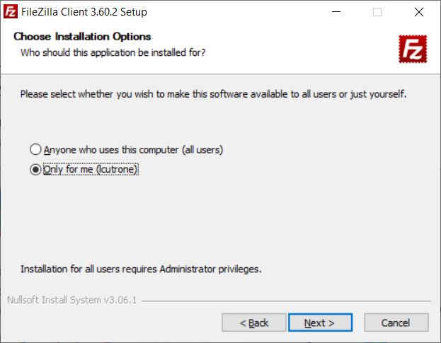
Filezilla
Choose Only for me Installation
Click Next

Slide 21
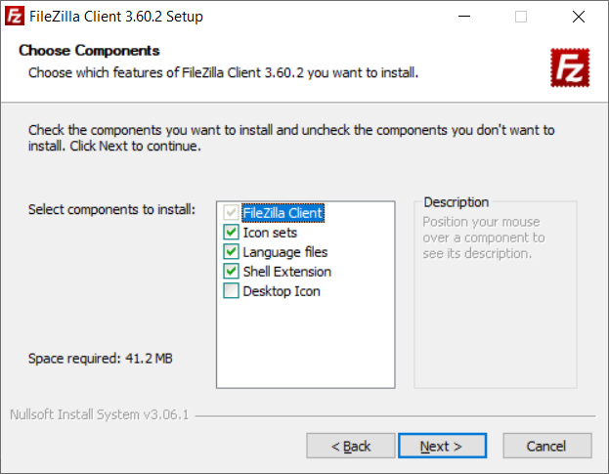
Filezilla
Choose the default options
Click Next

Slide 22
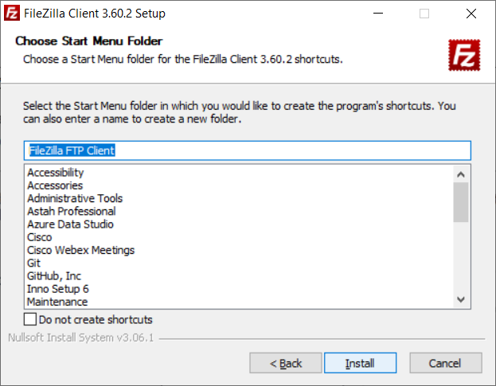
Filezilla
Choose the default Start Menu folder
Click Next

Slide 23
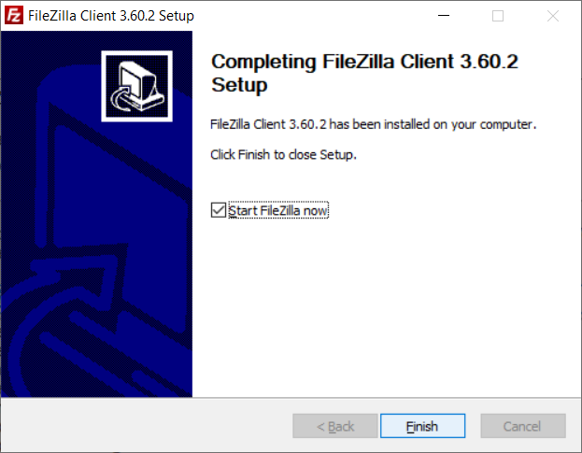
Filezilla
Deselect Start FileZilla now (optional)
Click Finish

